Slide 1
INFS4205/7205 Advanced Techniques for High Dimensional Data Managing Spatiotemporal Data
By Prof Xiaofang Zhou, Dr Lei Li and Dr Pingfu Chao
The University of Queensland

Slide 2
Learning Modules
 | Date | Lecture | Lecturer
1 | 22/6 | Course Introduction and RDBMS Review | Prof Xiaofang Zhou
2 | 22/6 | Introduction to Spatial Databases
3 | 23/6 | Spatial Data Organisation | Dr Lei Li
4 | 23/6 | Spatial Query Processing
5 | 24/6 | Managing Spatiotemporal Data | Dr Pingfu Chao
6 | 24/6 | Managing High Dimensional Data | Dr Lei Li
 | 25/6 | 端午节
7 | 26/6 | Advanced Topic: Route Planning in Road Networks | Dr Lei Li
8 | 26/6 | Future Trends, Course Review and Discussions | All
 |  | Revision Period
 | 9 July | Final Report Due

Slide 3
Learning Objectives
What we will cover
Spatiotemporal Data and Queries
Spatiotemporal Indexing and Query Processing
Trajectory Similarity Measures
Open issues and directions
Goals
Understand the temporal dimension of spatial data
Understand basics of spatiotemporal data management
Learn from examples about how to deal with new data management challenges brought by new data types

Slide 4
The Temporal Dimension
Location and time are two ubiquitous attributes of data
RDBMS is designed to handle neither of them
We have studied how the spatial dimension can be managed so far
The temporal dimension of spatial data cannot be simply viewed as just another dimension
Data values and operations/queries are quite different

Slide 5
Spatiotemporal Data
GPS recordings
Sensor data, RFID data and Surveillance data
Use of smartphones and smartcards
Use of location-aware apps
Social media data: uploaded photos/messages and check-in data
Much more spatiotemporal data to come with 5G
…and beyond the geographical domain

Slide 6
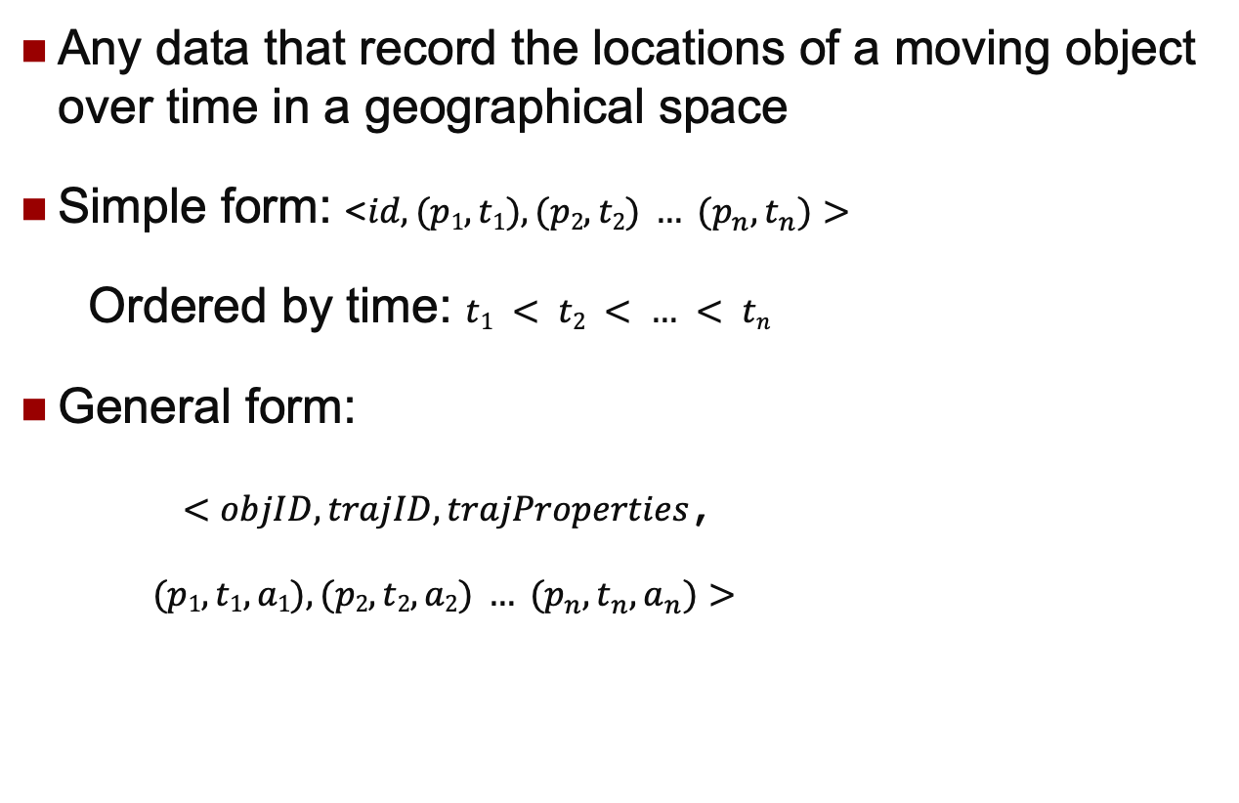
What is Trajectory Data
Any data that record the locations of a moving object over time in a geographical space
Simple form: <$id, (p1,t1), (p2,t2) … (p_{n},t_{n})>$
Ordered by time: $t1 < t2 < … < tn$
General form:
$<objID, trajID, trajProperties$,
$(p1,t1,a1),(p2,t2,a2) … (p_{n},t_{n},a_{n})>$

Slide 7
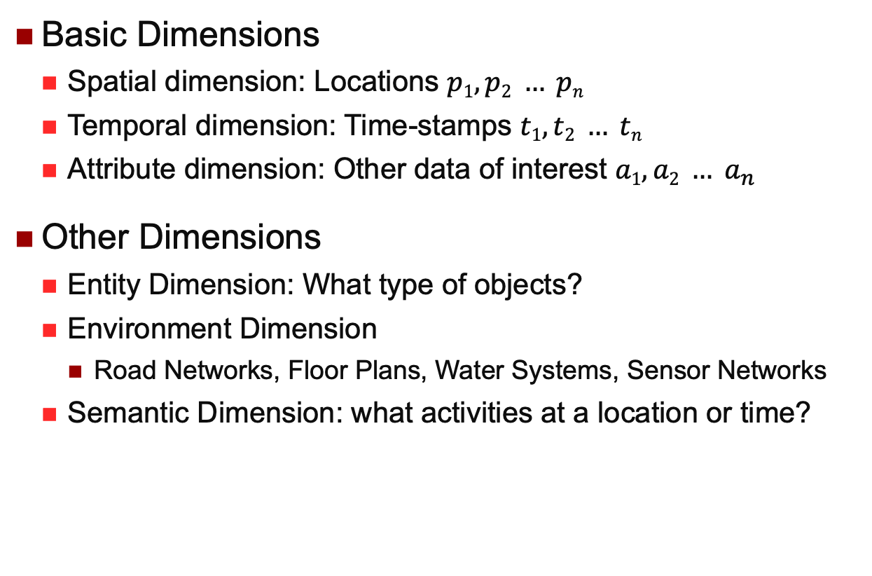
Many Dimensions of Trajectory Data
Basic Dimensions
Spatial dimension: Locations $p1, p2 … pn$
Temporal dimension: Time-stamps $t1, t2 … tn$
Attribute dimension: Other data of interest $a1, a2 … a_{n}$
Other Dimensions
Entity Dimension: What type of objects?
Environment Dimension
Road Networks, Floor Plans, Water Systems, Sensor Networks
Semantic Dimension: what activities at a location or time?

Slide 8
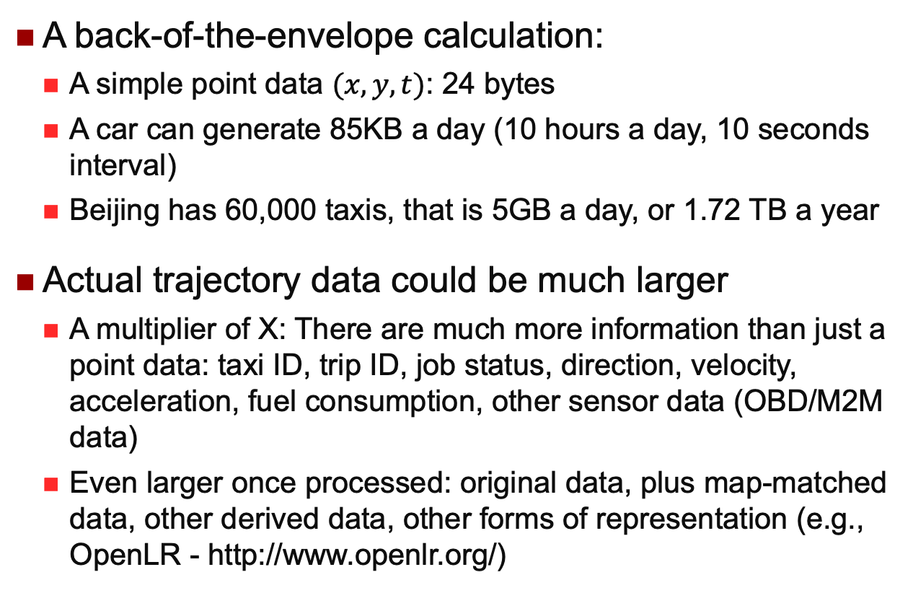
How Much Trajectory Data?
A back-of-the-envelope calculation:
A simple point data $(x,y,t)$: 24 bytes
A car can generate 85KB a day (10 hours a day, 10 seconds interval)
Beijing has 60,000 taxis, that is 5GB a day, or 1.72 TB a year
Actual trajectory data could be much larger
A multiplier of X: There are much more information than just a point data: taxi ID, trip ID, job status, direction, velocity, acceleration, fuel consumption, other sensor data (OBD/M2M data)
Even larger once processed: original data, plus map-matched data, other derived data, other forms of representation (e.g., OpenLR - http://www.openlr.org/)

Slide 9
Trajectory Data in a Company
A car navigation service provider
Total trajectory data: 32 TB in size, 10.9 billion matched trajectories
Every day, ~40M new trajectories, ~4 billion points
Many types of related data: maps, accident reports, roadside data, surveillance video, weather, events, social media…
 | Current | Daily
Company X (in-car navigation provider) | 17.6TB | 15M trajectories
Company Y (map app provider) | 14.5TB | 5M trajectories
Company Z (social network) | 0.68TB | 18M trajectories
Notes:
3M points/min -> peak hours 10M/min

Slide 10
NavInfo DataHIVE (minedata.cn)
Vehicle | Infrastructure | Environment | People
Trajectories: | Standard maps | Weather | Voice and text
- taxis | High res maps | Events | User comments
- uber-like | Services POIs | Air quality | Search log
- monitored | Culture POIs | Water quality | Travel log
- commercial | Commercial POIs | Land & water info | Operators’ OD
- user generated | Health POIs | DEM & EEC | Workplace info
Sensor/OBD data | Travel POIs | Satellite image
Perception data | City models | Street views
 | City 3D Models | Roadside pictures
 | Business districts | Laser point cloud
 | Admin boundaries | Road condition
 | Organization maps | Traffic condition
 |  | Traffic incidents

Slide 11
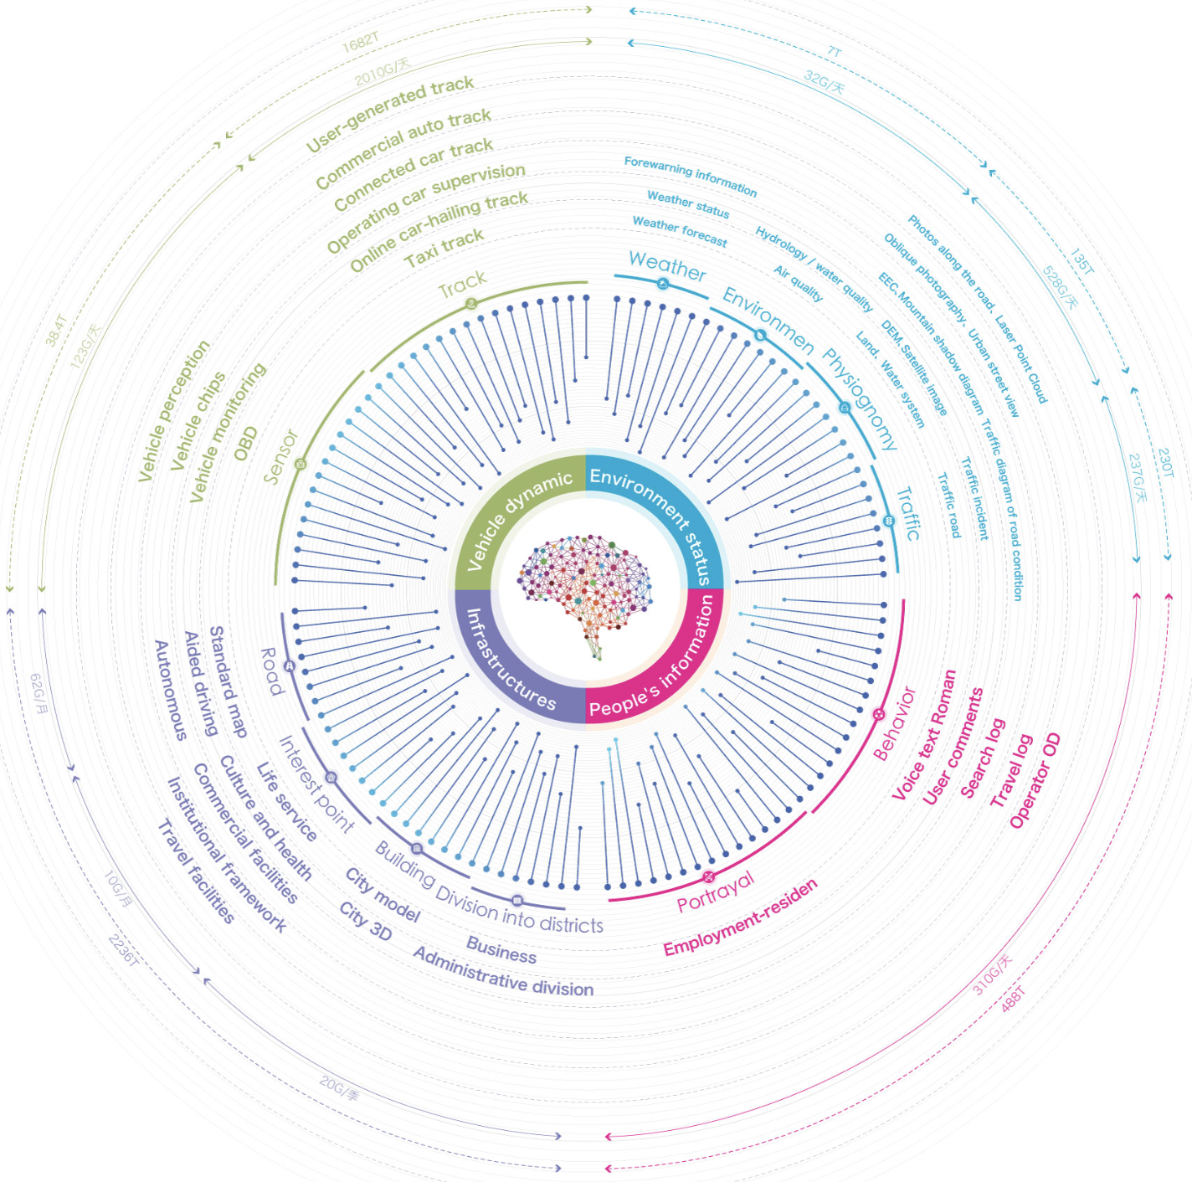
How Much?

Slide 12
Applications
Understanding, monitoring, predicting mobility patterns
…from very large amount of movement data in real-time
Some examples
Finding the nearest businesses or services
Location/movement-based event/service recommendations, alerts (sales, traffic jam, warnings…) and information push (e.g., advertisement)
Resource tracking and scheduling (e.g., for fleet management)
Safe drivers (e.g., for insurance industry)
Data-driven ITS (Intelligent Transportation System), urban planning and smart cities
…

Slide 13
Alternative Names
Moving objects data concern the current and future locations
Spatial trajectory data is the movement history of moving objects
A trajectory without the time dimension is also called a route

Slide 14
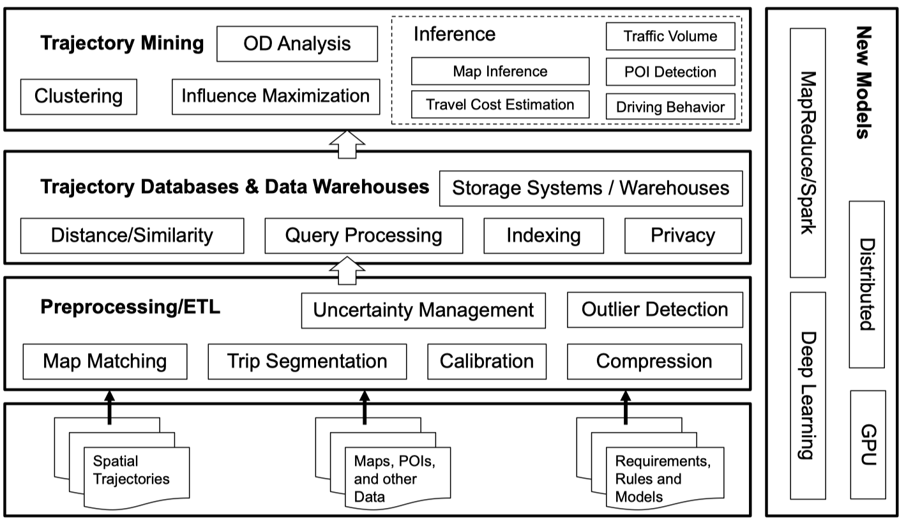
Spatiotemporal Data Management

Slide 15
Spatiotemporal Queries
Simple point/range queries are useful
Spatiotemporal point/window queries: a combination of timestamp/time interval and spatial point/region
Examples:
To find where an object is at time t
To find all the objects at/near location p at time t
To find all objects inside a given region during a given period…
Query can also take a trajectory as an input
To find the nearest POI for a given trajectory
To find top-K most similar trajectories to a given trajectory

Slide 16
More Spatiotemporal Queries
More challenging queries
Monitoring queries: also called continuous queries
Predicative queries: at a future point of time
Data analytics queries
To find trajectory clusters
To find where traffic jams could occur in the next 30 minutes
To find where people come from to a given region
…can you give soe examples for each type of queries?

Slide 17
Example: Continuous NN Query
Where is the nearest petrol station?
Static NN query
Concerning a given location
Optimization goal: minimize the number of objects to be examined
Moving NN query
Concerning the current location which is moving
Optimization goal: minimize the number of calls to the NN algorithm
Safe region: the results don’t change within the region
how?
…path NN query: where is the nearest petrol station on my way from city to Surfer’s Paradise?

Slide 18
Indexing Spatiotemporal Data
R-tree has been the most efficient and widely used general purpose spatial indexing structure, so let’s extend that for spatiotemporal data
What’s special now?
The time dimension increases monotonically and unbounded
An object can have a long sequence of locations (i.e., points), and those locations which are temporally close to each other are often spatially close too
MBR has been used as the foundation for R-tress, but now the MBR for an object or a group of objects either changes over time or occupies a huge space

Slide 19
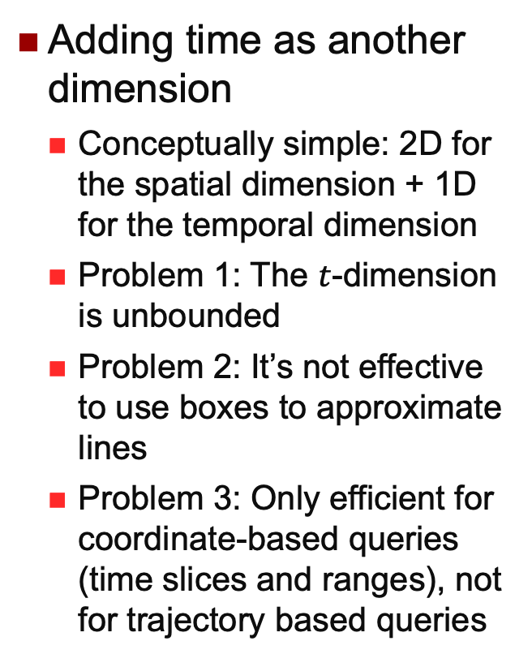
3D R-tree?
Adding time as another dimension
Conceptually simple: 2D for the spatial dimension + 1D for the temporal dimension
Problem 1: The $t$-dimension is unbounded
Problem 2: It’s not effective to use boxes to approximate lines
Problem 3: Only efficient for coordinate-based queries (time slices and ranges), not for trajectory based queries
t
y
x
Notes:
T-dimension unbounded: leading to severe overlapping of all boxes (at least on this dimension)
Box-bad-for-line: even more so in 3D

Slide 20
Snapshot-Based Indexing
One R-tree for each snapshot?

Slide 21
HR-Tree
Historical R-tree
An R-tree is maintained for each timestamp in history
Trees at consecutive timestamps may share branches to save space
o₃
o₄
timestamp 1
o₁
o₆
p₂
o₅
p₁
o₂
timestamp 1
p₁
p₂
p₃
p₃
o₇
o₁
o₂
o₃
o₄
o₅
o₆
o₇
“Towards Historical R-trees”, M. Nascimento and J. Silva, ACM Symposium on Applied Computing, 1998.

Slide 22
HR-Tree: Sharing Branches
o₃
o₄
timestamp 2
o₁
o₆
p₂’
o₅’
p₁
o₂
p₃’
o₇
timestamp 1
p₁
p₂
p₃
timestamp 2
p₁
p₂’
p₃’
o₁
o₂
o₃
o₄
o₅
o₆
o₇
o₃
o₄
o₃
o₄
o₅’
…what do you think about this approach?

Slide 23
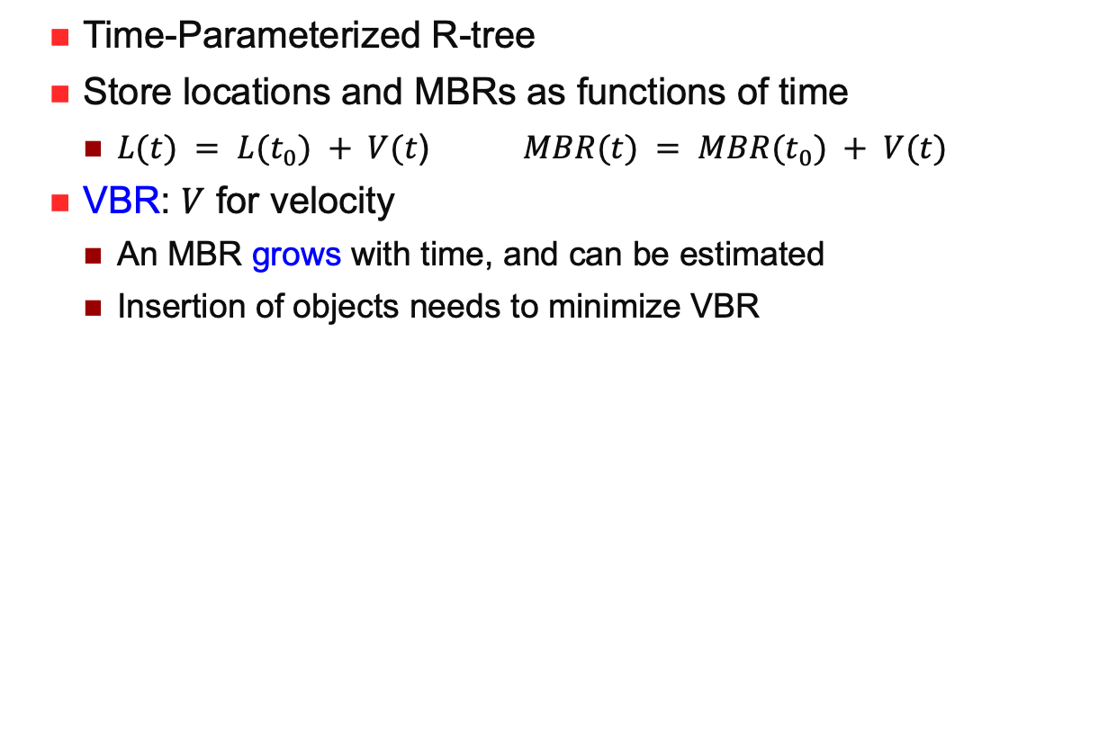
TPR-Tree
Time-Parameterized R-tree
Store locations and MBRs as functions of time
$L(t) = L(t_{0}) + V(t$) $MBR(t) = MBR(t_{0}) + V(t)$
VBR: $V$ for velocity
An MBR grows with time, and can be estimated
Insertion of objects needs to minimize VBR
(a) The boundaries at current time 0
(b) The boundaries at future time 1
“Indexing the Position of Continuously Moving Objects”, S Saltenis, C Jensen, S T Leutenegger and M. A. Lopez, SIGMOD 2000

Slide 24
Trajectory Data
Spatial trajectory is object movement history in a space
Continuous in nature, but discrete once captured and stored
Many location-update strategies
By time, by distance, by deviation…
A trade-off between accuracy and other overheads
Variations may not always be under control
Movement can be in a free space (e.g., birds flying), or a constrained space (e.g., cars in road networks)

Slide 25
Trajectory Similarity Measures
The foundation to perform trajectory based queries and analytics (such as clustering)
Many types of similarities
Sequence-based: passing the same sequence of points?
Geometry-based: similar shapes?
With or without time or speed considerations
Key factors to consider
Alignment of sampling points (to deal with non-uniform sampling)
Robustness to noise (to deal with data quality issues)
There are many trajectory similarity measures

Slide 26
Classification
Alignment of samples
Lock-step vs. adaptive alignment
Similarity metric
Geographical distance vs. count based
Continuity
Discrete vs. continuous
Dimension
Spatial-only vs. spatio-temporal
Underlying space
Euclidean space vs. road network

Slide 27
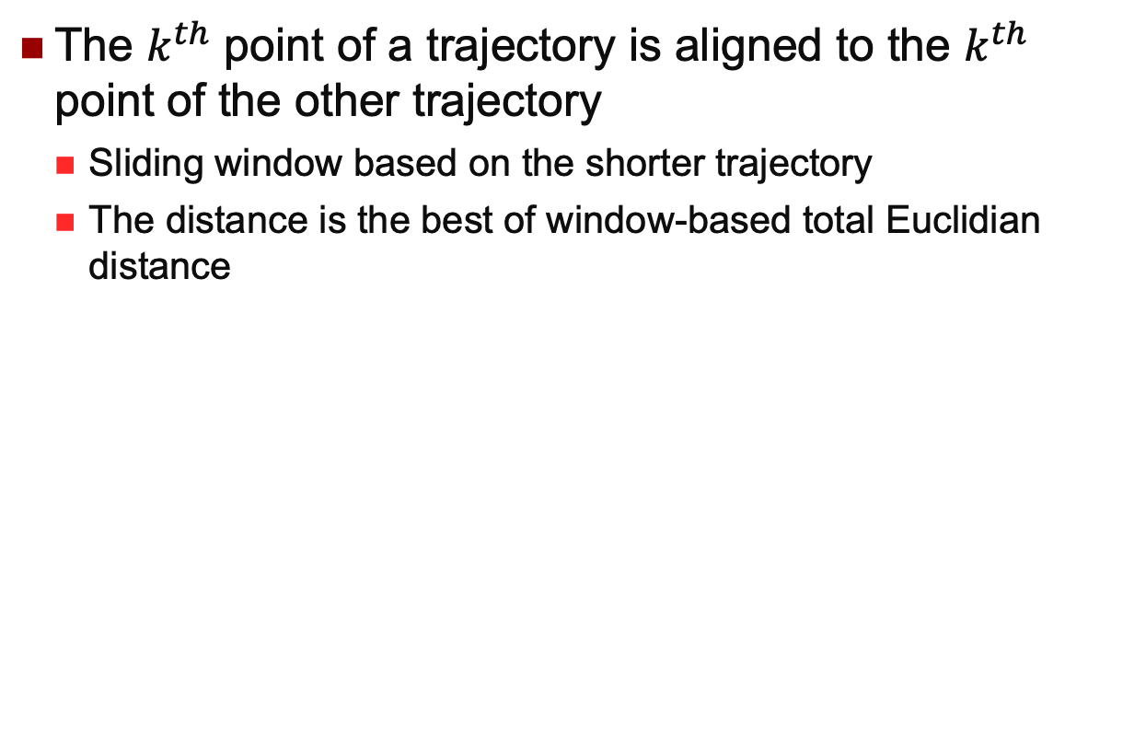
Lock-Step Alignment
The $k^{th}$ point of a trajectory is aligned to the $k^{th}$ point of the other trajectory
Sliding window based on the shorter trajectory
The distance is the best of window-based total Euclidian distance
… what is the time complexity of this approach?

Slide 28
Drawback
Cannot find similar trajectories with different sampling rates, which are common in practice
Sensitive to noise

Slide 29
Adaptive Alignment
Dynamic Time Warping (DTW) distance
Adaptation from time series distance measure
Used to handle time shift and scale in time series
Optimal order-aware alignment between two sequences
Goal: minimize the aggregate distance between matched points
1-to-many mapping: one point in one sequence can be mapped to multiple points in another sequence
Yi, Byoung-Kee, Jagadish, HV and Faloutsos, Christos, Efficient retrieval of similar time sequences under time warping. ICDE 1998

Slide 30
DTW for Trajectories
Useful when detecting similar trajectories with different sampling rates
Using Dynamic programming to compute DTW. Check the Wikipedia page
Time complexity: O(MN)

Slide 31
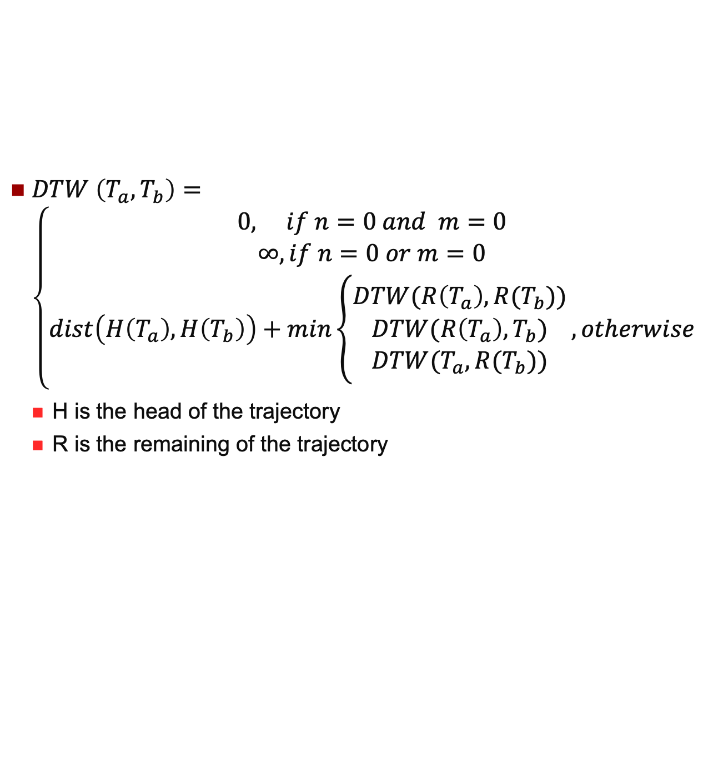
DTW Dynamic Programming
$DTW \left(T_{a},T_{b}\right)=\left\{\begin{aligned}0, if n=0 and & m=0 \\ ∞, if n=0 or m=0 \\ dist\left(H\left(T_{a}\right),H\left(T_{b}\right)\right)+min\left\{\begin{aligned}DTW(R\left(T_{a}\right),R(T_{b})) \\ DTW(R\left(T_{a}\right),T_{b}) \\ DTW(T_{a},R(T_{b}))\end{aligned}\right., otherwise\end{aligned}\right.$
H is the head of the trajectory
R is the remaining of the trajectory
Using Dynamic programming to compute DTW. Check the Wikipedia page
Time complexity: O(MN)

Slide 32
Count-Based Similarity
So far, geographical distance based
Similarity is measured by the geographical distance between matched samples
Count based
Similarity is measured by the number of ‘similar’/ ‘dissimilar’ samples
Based on Edit Distance
The distance between two strings is the minimum number of operations (insert, edit or replace) to transform one string to another
Now introducing a “close” threshold so two points are consider as the same when they are close enough
LCSS: count the similar sample pairs
EDR: count the dissimilar sample pairs
Edit Distance is computed using dynamic programming. Check the Wikipedia page

Slide 33
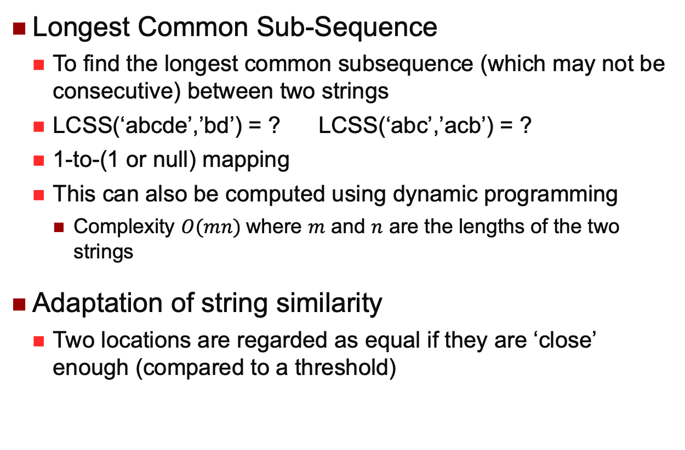
LCSS
Longest Common Sub-Sequence
To find the longest common subsequence (which may not be consecutive) between two strings
LCSS(‘abcde’,’bd’) = ? LCSS(‘abc’,’acb’) = ?
1-to-(1 or null) mapping
This can also be computed using dynamic programming
Complexity $O(mn)$where $m$ and $n$ are the lengths of the two strings
Adaptation of string similarity
Two locations are regarded as equal if they are ‘close’ enough (compared to a threshold)
VLACHOS, M., GUNOPULOS, D., AND KOLLIOS, G. Discovering similar multidimensional trajectories. ICDE 2002
Notes:
LCSS(‘abcde’,’bd’) = ‘bd’ LCSS(‘abc’,’acb’) = ‘ab’ or ‘ac’

Slide 34
LCSS
Insensitive to noise
Not easy to define threshold
May return dissimilar trajectories
p₅
p₃
p₄
p₂
p’₃
p’₁
p₁
p’₂

Slide 35
EDR
Edit Distance on Real sequence
Adaptation from Edit Distance on strings
Number of insert, delete, replace needed to convert one string into another
Two locations are regarded as equal if they’re ‘close’ enough (compared to a threshold)
Lei Chen, M. Tamer Ozsu, Vincent Oria, Robust and Fast Similarity Search for Moving Object Trajectories. SIGMOD 2005

Slide 36
EDR
Value means the number of operations, not “distance between locations”
Insensitive to noise
replace
insert
p₅
p₃
p₄
p₂
p’₃
insert
p’₁
p₁
p’₂

Slide 37
LCSS and EDR
They are both count-based
LCSS counts the number of matched pairs
EDR counts the cost of operations needed to fix the unmatched pairs
Higher LCSS, lower EDR

Slide 38
Continuity
So far, discrete measures only
Only consider the sample points of trajectory
All previous measures are in this category
Continuous measures
Consider the line segments between samples
OWD
LIP

Slide 39
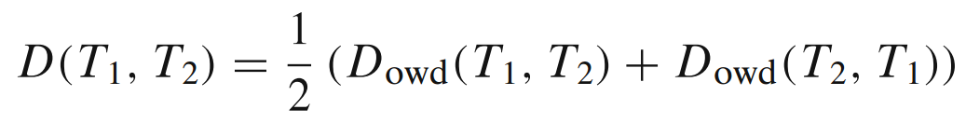
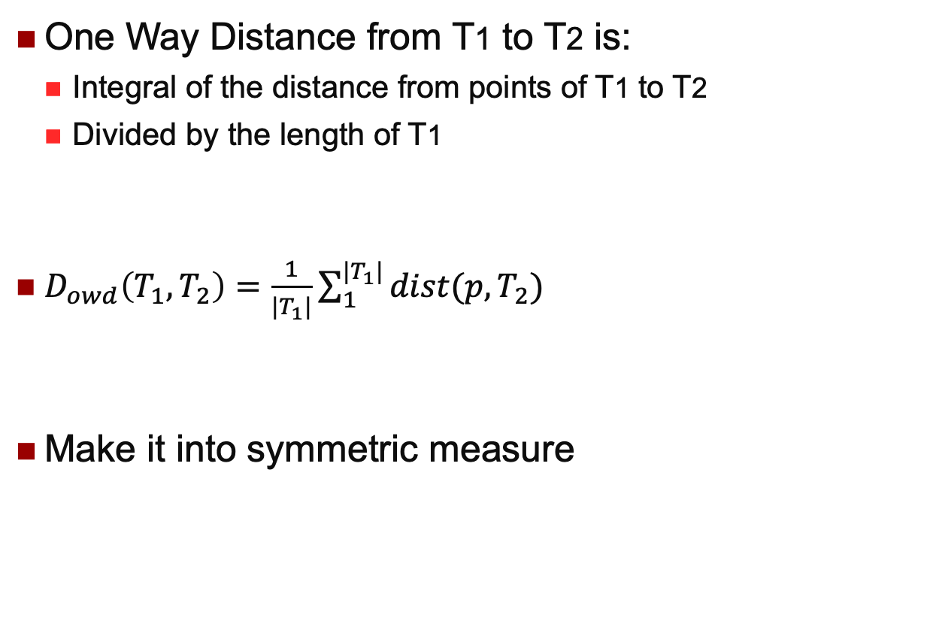
OWD
One Way Distance from T1 to T2 is:
Integral of the distance from points of T1 to T2
Divided by the length of T1
$D_{owd}\left(T_{1},T_{2}\right)=\frac{1}{|T_{1}|}\sum_{1}^{|T_{1}|}{dist(p,T_{2})}$
Make it into symmetric measure
Bin Lin, Jianwen Su, One Way Distance: For Shape Based Similarity Search of Moving Object Trajectories. In Geoinformatica (2008)

Slide 40
OWD example
Consider one trajectory as piece-wise line segment, and the other as discrete samples

Slide 41
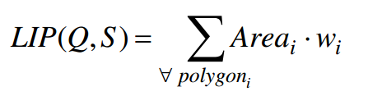
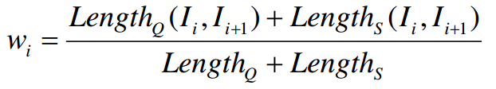
LIP distance
Locality In-between Polylines
Polygon is the set of polygons formed between intersection points
Nikos Pelekis et al, Similarity Search in Trajectory Databases. Symposium on Temporal Representation and Reasoning 2007

Slide 42
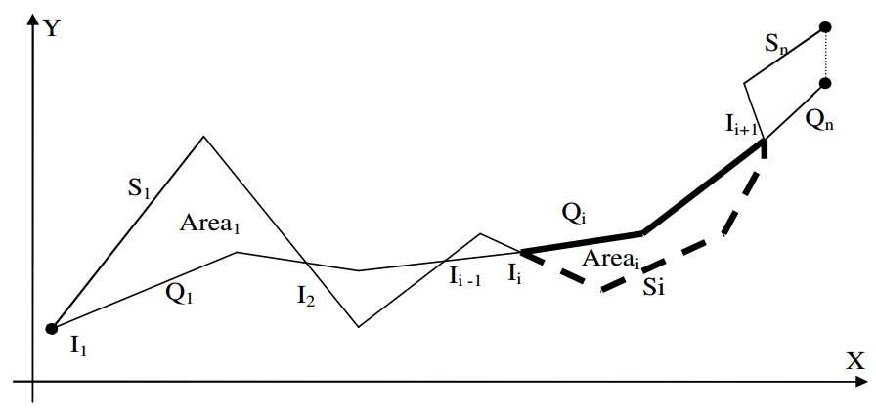
LIP distance
Only works for 2-dimensional trajectories
Polygon → polyhedron: non-trivial change

Slide 43
Spatiotemporal Distances
So far, spatial only
Disregard the time information on sample points
Spatiotemporal
Take the timestamp into consideration
Synchronous Euclidean Distance

Slide 44
SED
Synchronous Euclidean Distance
Euclidean distance between locations at the same time instance of two trajectories
Virtually create a sample point at t=3
t=10
t=20
t=0
t=5
t=15
t=25
t=3
t=10
t=12
t=0
t=7
Mirco Nanni, Dino Pedreschi, Time-focused clustering of trajectories of moving objects. Journal of Intelligent Information Systems (2006)
POTAMIAS, M., PATROUMPAS, K., AND SELLIS, T. K. Sampling trajectory streams with spatiotemporal criteria. SSDBM 2006

Slide 45
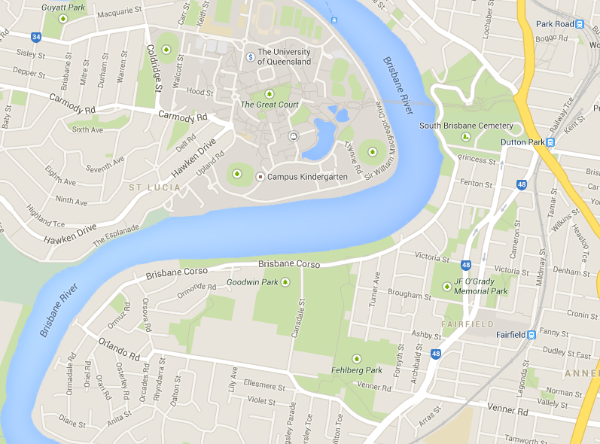
Underlying Space
We have considered on the Euclidean Space so far
Road network
Distance is defined along shortest path
Jung-Rae Hwang, Hye-Young Kang, Ki-Joune Li, Searching for Similar Trajectories on Road Networks Using Spatio-temporal Similarity. Advances in Databases and Information Systems, pp 282 – 295, 2006

Slide 46
Trajectory Compression: The Need
One record every 10 s, 24 bytes/record (min), 10 hrs/day
Significant level of redundancy (i.e., the need for compression)
Data quality can be poor (i.e., lossless compression may not be meaningful)
 | Day | Month | Year
1 object | 84KB | 2.5MB | 30MB
60,000 taxis | 5GB | 140GB | 1.7TB

Slide 47
Simplification and Compression
Trajectory Simplification
Removing redundant information in a trajectory
Trajectory Compression
Reduce the amount of data without too much information loss
Questions
Goals: size, quality, fitness for use, processing efficiency…
Intra-, inter- or knowledge-assisted?
That is, within one trajectory, among a set of trajectories, and use of other information such as road network information or some kind of dictionary and patterns
Geometric, spatiotemporal, semantic?

Slide 48
Data Compression
Run length encoding
Bit-vector
Dictionary encoding
Frame of reference encoding
Differential encoding (escape sequence)
Heavyweight encoding
Notes:
RLE: 12W1B3C
Bit vector: considering data as binary bits and then use compressing methods such as RLE
Dictionary encoding: have a dictionary of (frequent-strings, code) and then use code to represent strings
Frame of reference encoding (delta encoding): replace several large numbers by the first number followed by deltas
Differential encoding: using deltas (and escape sequence: not to record the numbers for short runs)

Slide 49
Notes:
Mathematically, frame-of-reference and delta coding use the same principle: we apply an invertible transformation that maps a set of (relatively) large integers to mostly smaller integers.

Slide 50
Line Simplification
Piecewise linear approximation
Curves and spline based methods do exist but seldom used
Naïve reduction methods
Every a few points, or every given distance
Two subproblems
Min-ε: minimize error for a given maximum number of points
Min-#: minimize #points for a given error threshold
Research areas: computational geometry, spatial database and GIS, pattern recognition, signal processing, image processing…

Slide 51
Criteria of Line Simplification
In cartography (Weibel 1997)
(1) Reduction of data size and complexity
(2) Emphasizing the essential while suppressing the unimportant
(3) Maintaining logical and unambiguous relations
(4) Preserving aesthetic quality
For us?
(1) and (2) above remain to be important
Need to establish the context and refine the criteria
(3) is hard to define, but is still important
Don’t introduce misleading information (passing obstacle areas)
Support similarity-based operations
(4) might be unimportant
Any new criteria?
"Generalization of spatial data: Principles and selected algorithms", R. Weibel, in Algorithmic Foundations of Geographic Info. Sys., 1997

Slide 52
Lang’s Algorithms
A first step beyond removing random points (e.g. every 2nd point) or looking at the immediate neighboring points (all points within a pre-defined distance)
From point i, check between i and i+k (i.e., looking ahead)
Draw a line L between i and i+k
Find perpendicular distance from i+1, …, i+k-1 to L
Remove all points i+1, …, i+k-1 if the distance is acceptable, and move the start point to i+k; otherwise k-- and repeat
Notes
Only use a subset of existing points? Noisy data?
Prior-knowledge (such as a map) and post-processing (such as non-self crossing)
“Rules for robot draughtsmen”, T. Lang, Geographical Magazine, 1969

Slide 53
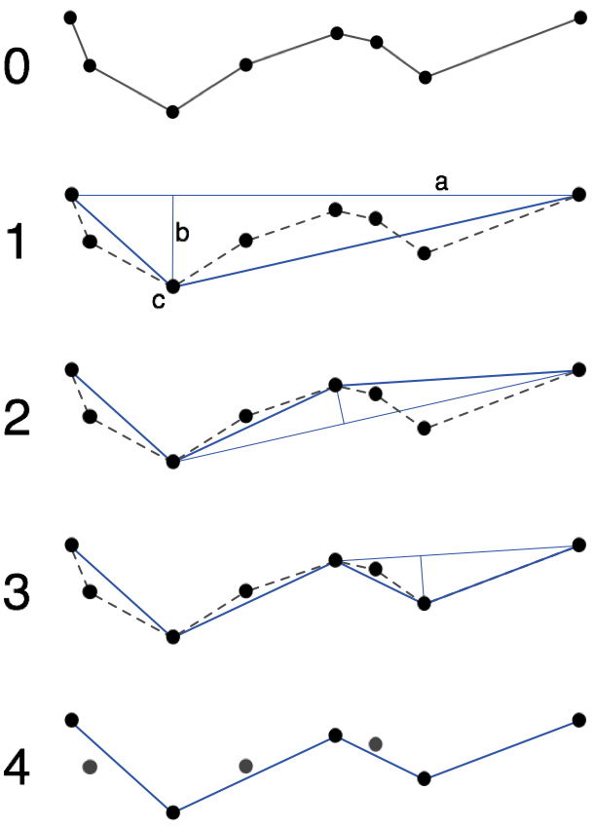
Douglas-Peucker Algorithm
A classic algorithm, simple, and “most superior”
Top-down, to check if the deviation from a straight line is acceptable
Computationally costly: O(n²), reducible to O(n log n)
‘Area difference’ can be used to measure too
"Algorithms for the reduction of the number of points required to represent a digitized line or its caricature", D. Douglas & T. Peucker, The Canadian Cartographer, 1973

Slide 54
Li-Openshaw Algorithm
Naturally adaptive to visual effects
SVS: smallest visible size
Aka Scale-specific or multiresolution generalization, a raster-vector approach
All points within a SVS (a pixel) collapse into one (the centroid)
Many benefits (see Weibel’s criteria)
“Algorithms for objective generalization of line features based on the natural principle”, Z. Li and S. Openshaw, IJGIS, 1992

Slide 55
Temporal DP for Trajectories
Let (p_{i}, …, p_{j}) be the subcurve to simplify, the perpendicular distance from p_{k}, i < k < j, to line (p_{i,}p_{j}) is replaced by the Synchronous Euclidean Distance between (p_{k}, p’_{k}):
O(n log n)
Can use spatiotemporal error measures: Threshold-guided distance (SSDBM 2006), spatial join distance (VLDBJ 2006) and Fréchet distance (Int’l J Comp. Geometry and App.1995) – note: yet to study these
Used in our VLDB 2008 work
“A new perspective on trajectory compression techniques”, N. Meratnia and R. A. de By, EDBT 2004

Slide 56
With Network Constraints
Consider map-matching and trajectory compression at same time （by different orders)
Map-matching by Brakatsoulas, Pfoser, Salas and Wenk (VLDB 2005)
Trade-off between compression ratio and similarity
New idea: using shortest path for compression
Between which pair of points?
Key technique: minimum description length (MDL)
L(H) + L(D|H) (for compression and differences caused)
Need to consider all-pair combination to optimize
Using a greedy approach, with pre-computed requires all-pair SP
“Trajectory compression under network constraints”, G. Kellaris, N. Pelekis and Y. Theodoridis, SSTD 2009

Slide 57
Semantic Compression
Only use those semantically more important points
Curve apexes? Road intersections? Transit points?
Compress a trajectory into a sequence of events
Events: street intersections, public transport stops
Movement by direction (e.g., straight, left) or by event labels
Compression by combining consecutive homogeneous events
Decompress to paths only with important events with estimated timestamps based on linear behavior of movement
“Semantic trajectory compression”, F. Schmid, K.-F. Richter and P. Laube, SSTD 2009

Slide 58
Mapping Trajectories to Events
Map trajectories to activities by considering the nearest neighbor constraint and time duration constraint
The focus is on efficient join processing
A set of trajectories
A set of POIs associated with activities and min/max durations
A part of a trajectory can be linked to an activity (or multiple activities) if the corresponding POI is the nearest of that part of trajectory and the duration meets the min/max time constraint
“From trajectories to activities: a spatiotemporal join approach”, K. Xie and X. Zhou, ACM GIS-LBSN 2009

Slide 59
Trajectory Rewriting: The Need
A case study
Using 4 popular similarity measures, average normalized distance values over 1000 dense trajectories rewritten to different sampling rates
Sampling rate | ED | DTW | LCSS | EDR
10 | 0.35 | 0.21 | 0.41 | 0.55
20 | 0.21 | 0.09 | 0.27 | 0.37
30 | 0 | 0 | 0 | 0
60 | 0.24 | 0.15 | 0.33 | 0.23
100 | 0.25 | 0.21 | 0.45 | 0.28

Slide 60
Reference System Based Rewriting
To make heterogeneous trajectories compatible by rewriting
Four reference systems
Grid-based
Data-based
POI-based
Feature-based
Two rewriting operations
Alignment and compliment
“Calibrating trajectory data for similarity-based analysis”, H. Su, K. Zheng, H. Wang and X. Zhou, SIGMOD 2013

Slide 61
Trajectory Mining
Trajectory clustering (SIGMOD 2007)
Partition-and-group, and partition based on MDL
Trajectory pattern mining (ICDE 2008)
Long trajectories are divided based a duration T, and then they are aligned and points are density-based clustered
Finding convoys (VLDB 2008)
A group of objects travelling together for long enough
Used line simplification algorithms for efficiency
Finding “swarms” (VLDB 2010)
Allow temporary divergence

Slide 62
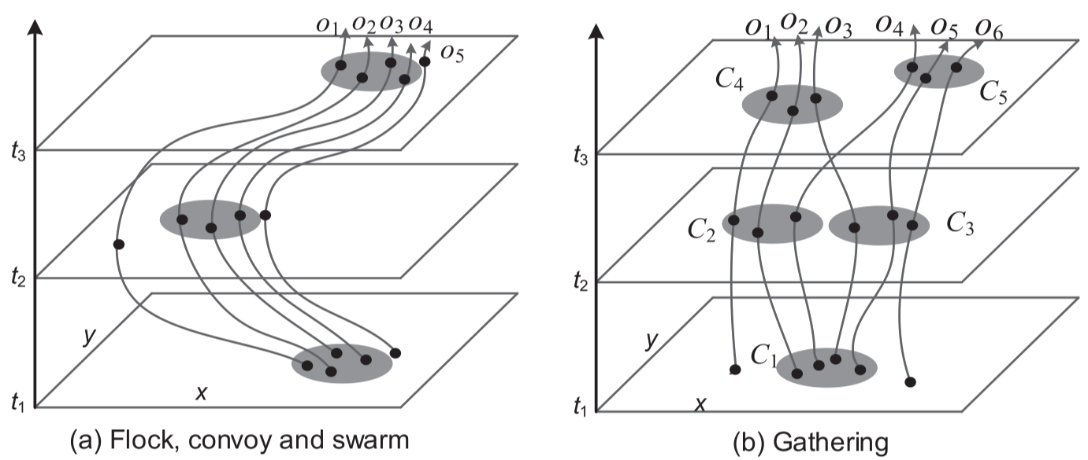
Trajectory Mining

Slide 63
Summary
Spatiotemporal data is common
Spatiotemporal data indexing and query processing are different from spatial ones
Trajectory data is of particular importance with a wide range of applications
Raw trajectory data cannot be compared directly
Trajectory analytics is a new research direction

